Slide 1

CSE211
Computer Organization and Design
Lecture : 3 Tutorial: 1 Practical: 0 Credit: 4
Deepak Kumar
(Asst. Professor, LPU)

Slide 2
Overview
Computer Arithmetic's
Addition and Subtraction
Multiplication Algorithms
Division Algorithms
Decimal Arithmetic Unit
BCD Operation
Decimal Arithmetic operations

Slide 3
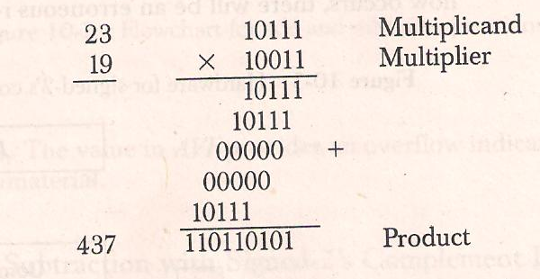
Binary Multiplication
Sign of product determined from sign of Multiplicand and Multiplier , if same +ve else -ve

Slide 4
H/W implementation -Multiplication
For multiplication in hardware, process is slightly changed
In place of as Register equal to no. of multiplier bits, use one adder and one Register
Instead of shifting multiplicand to left , partial product is shifted right
When corresponding bit of multiplier is 0, no need to add zero to partial product

Slide 5
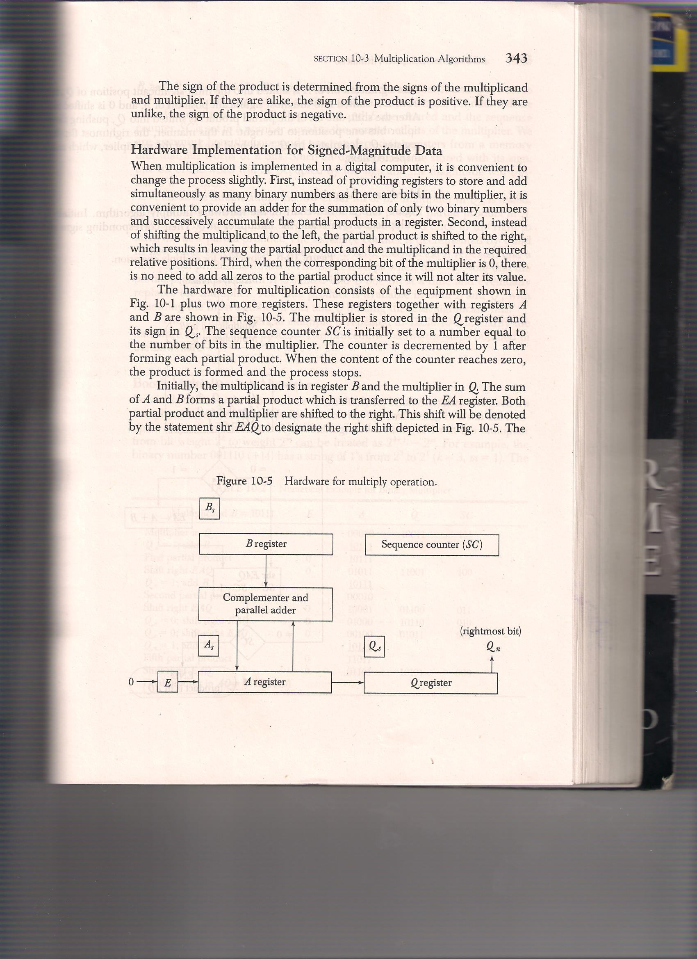
H/W implementation -Multiplication

Slide 6
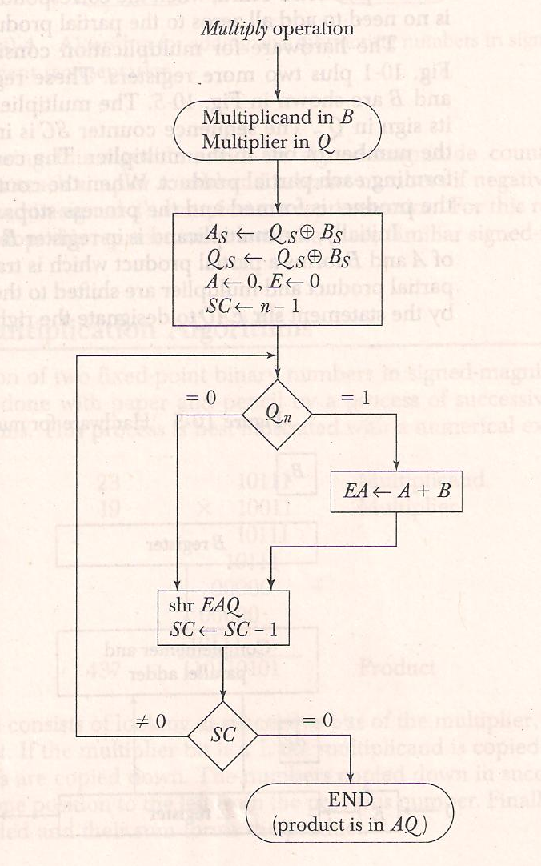
Flow Chart Binary Multiplication

Slide 7
Booth’s Multiplication Algorithm
Used for multiplication in Signed 2’s complement representation
It operates on the fact that strings of 0’s in the multiplier require no
addition but just shifting
And a string of 1’s in the multiplier from bit weight 2^{k} to 2^{m} can be
treated as 2^{k+1} – 2^{m}
E.g. +14 (001110 ) here k=3, m=1 represented as 2⁴-2¹ = 16-2 = 14
Thus M x 14= M x 2⁴ – M x 2¹

Slide 8
Booth’s Multiplication Algorithm
Used for multiplication in Signed 2’s complement representation
Prior to shifting the multiplicand can be added to the partial product , subtracted from the partial product or left unchanged according to the following rules :
The multiplicand is subtracted from partial product upon encountering the first least significant 1 in the string of 1’s in the multiplier
The multiplicand is added to the partial product upon encountering the first 0 (provided that there was a previous 1) in the string of 0’s in the multiplier.
The partial product does not change when the multiplier bit is identical to the previous multiplier bit

Slide 9
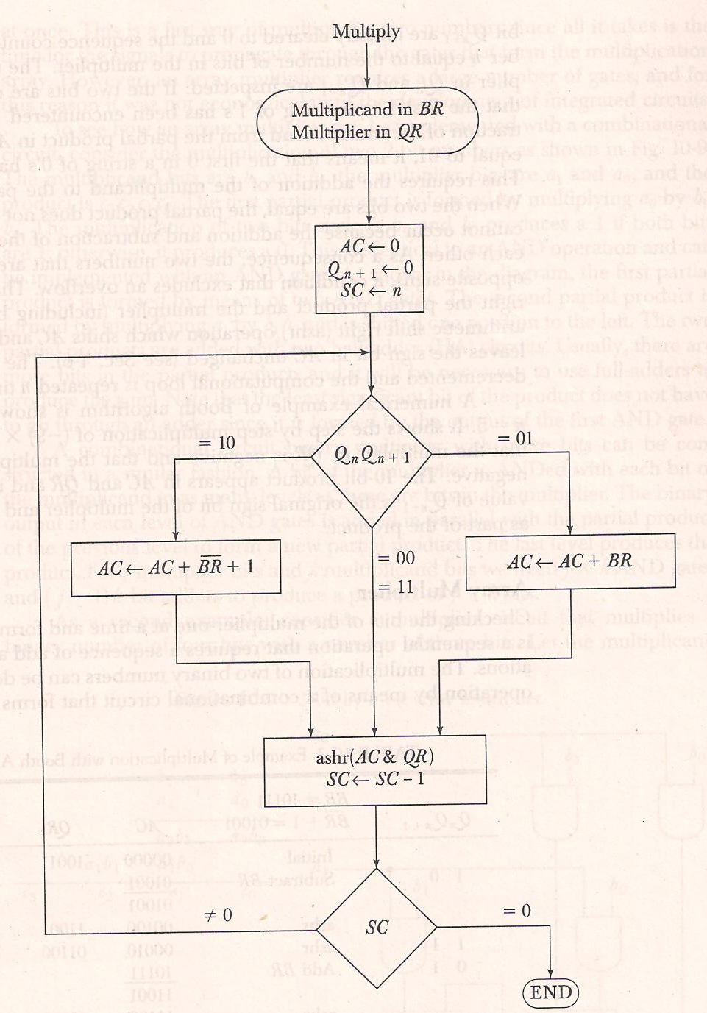
Booth’s Multiplication Algorithm

Slide 10
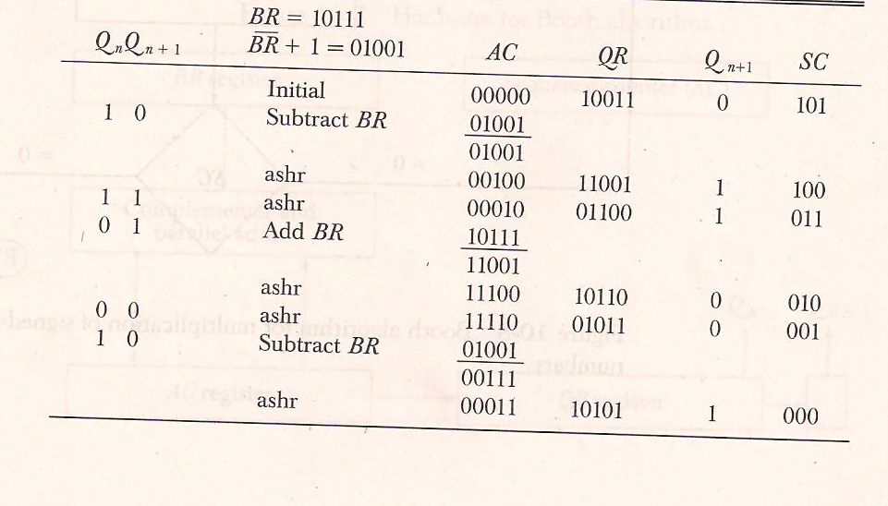
Example - Booth’s Multiplication Algorithm

Slide 11
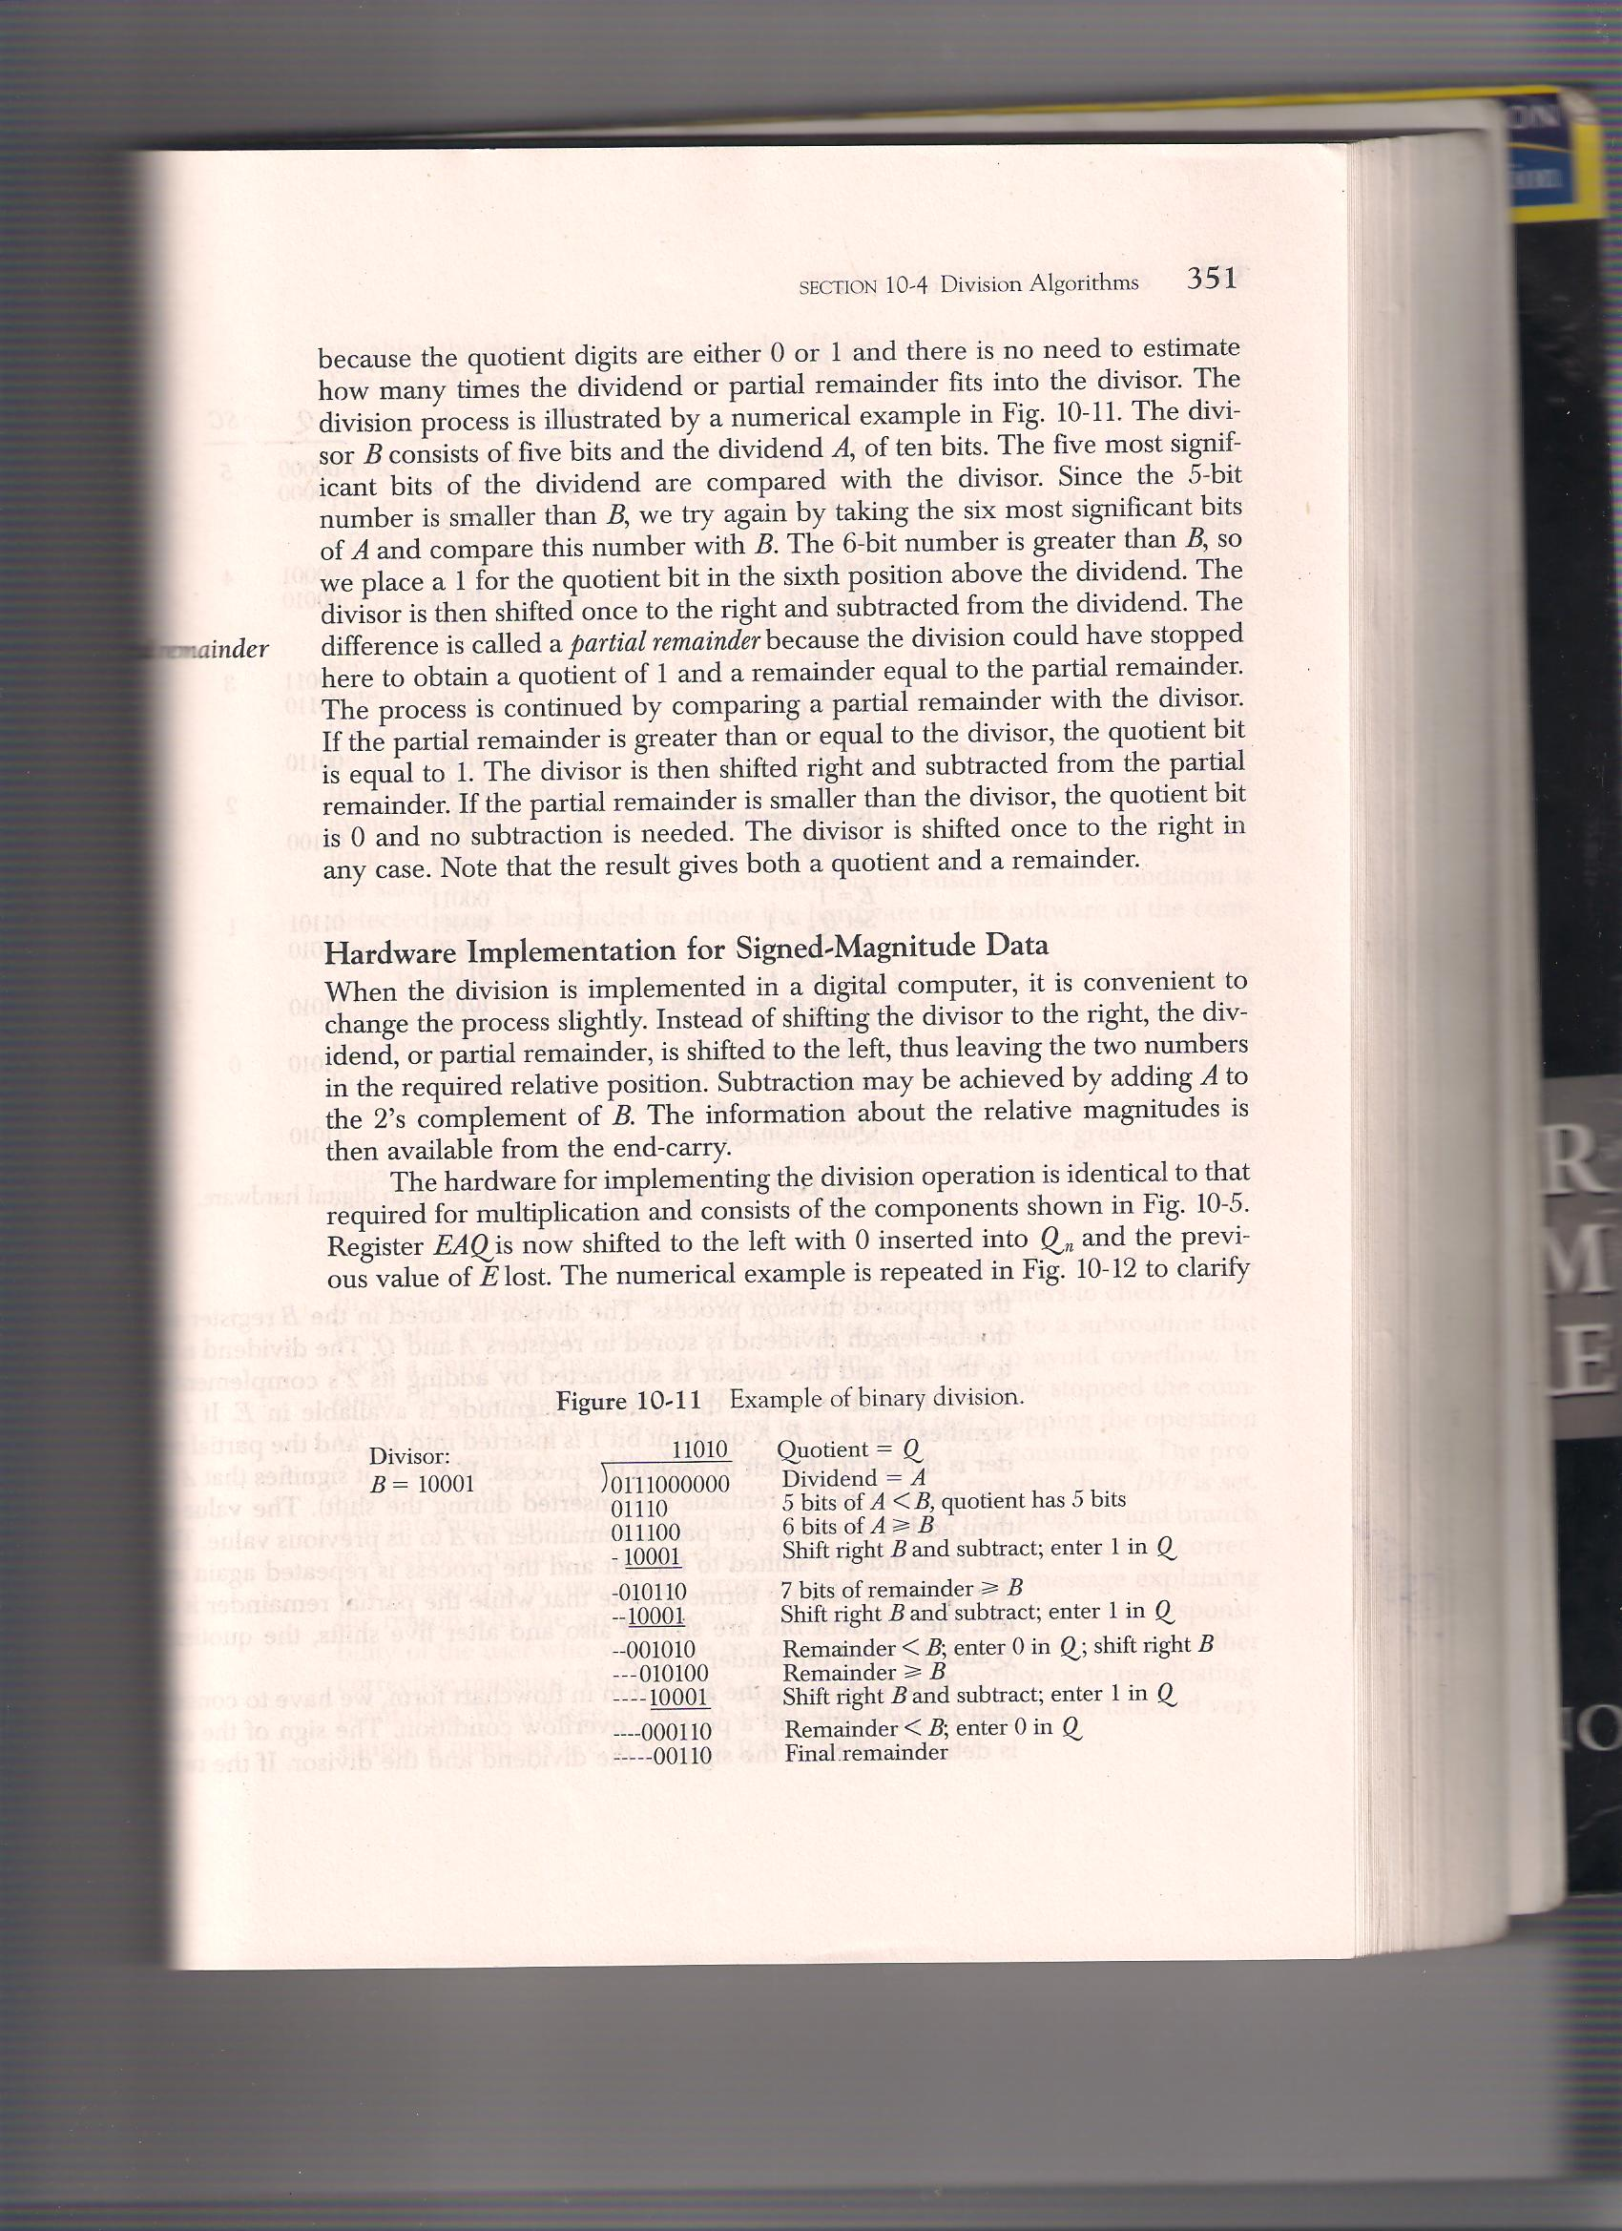
Binary Division

Slide 12
Binary Division
For Division in hardware, process is slightly changed
Instead of shifting divisor to right, dividend or partial remainder is shifted left
Subtraction achieved by adding A to 2’s complement of B
Information about Relative magnitude is available from the end carry
Hardware components identical to that of multiplication

Slide 13
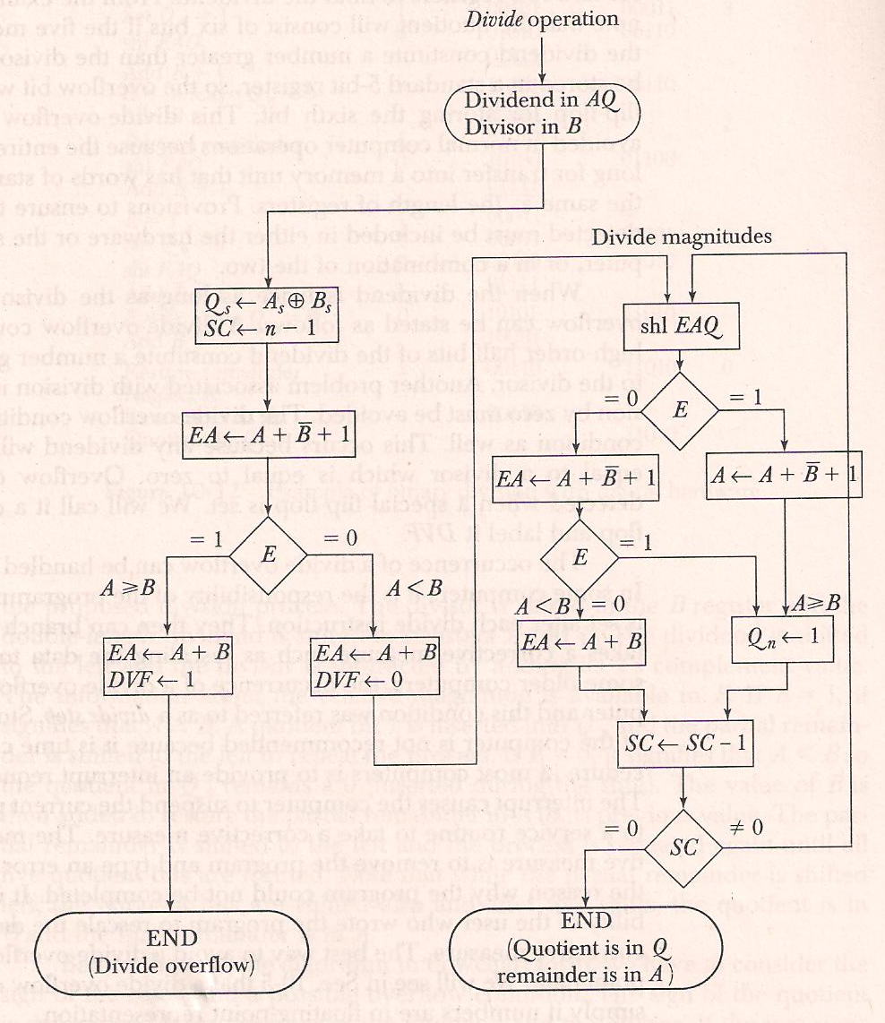
Flow Chart - Division

Slide 14
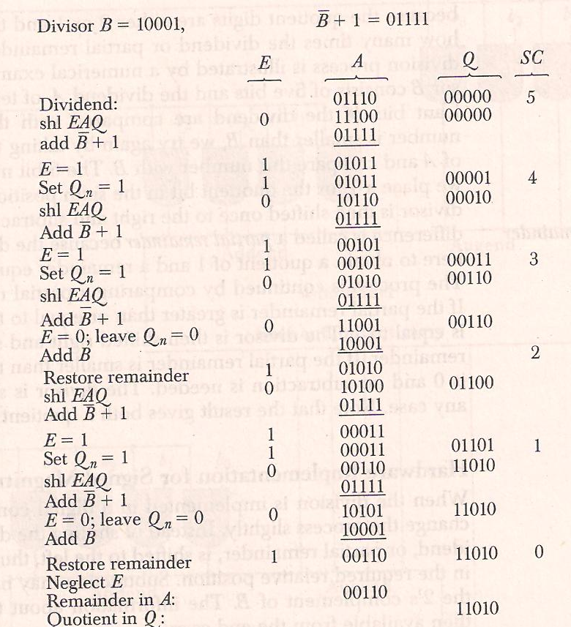
Example - Division

Slide 15



